Slide 1


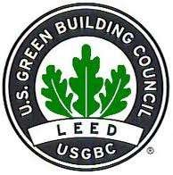
Green
Buildings

Slide 2
Green Buildings
•What?
•Why?
•How?

Slide 3
What are Green Buildings?

Slide 4
What are Green Buildings?
Green buildings are…
Buildings or homes that are more energy efficient, produce less waste and are healthier to be inside
•
•
Green buildings don’t literally mean…
• Buildings that produce zero-emissions or totally green or totally
environmentally friendly
•
Green building certification systems
• Certification systems by different organizations/institutions that
setup standards to quantify how ‘green’ a building is
• Different standards world wide, but similar in concept

Slide 5
Green Building
Certifications
•
•
•
Australia: Nabers / Green Star
Brazil: AQUA / LEED Brasil
Canada: LEED Canada / Green Globes /
Built Green Canada
China: GBAS Finland: PromisE France: HQE
Germany: DGNB / CEPHEUS Hong Kong: HKBEAM
India: Indian Green Building Council
(IGBC) / GRIHA
Indonesia: Green Building Council
Indonesia (GBCI) / Greenship
Italy: Protocollo Itaca / Green Building
Council Italia
Japan: CASBEE
Korea: KGBC
Malaysia: GBI Malaysia
Mexico: LEED Mexico
Netherlands: BREEAM Netherlands
•
•
New Zealand: Green Star NZ
Philippines: BERDE / Philippine Green
Building Council
Portugal: Lider A
Qatar: QSAS
Republic of China (Taiwan): Green
Building Label
Singapore: Green Mark
South Africa: Green Star SA
Spain: VERDE
Switzerland: Minergie
United States: LEED / Living Building
Challenge / Green Globes / Build it
Green / NAHB NGBS / International
Green Construction Code (IGCC) /
ENERGY STAR
United Kingdom: BREEAM United Arab Emirates: Estidama IAPGSA Pakistan Institute of
Architecture Pakistan Green Sustainable
Architecture
Jordan: EDAMA
Czech Republic: SBToolCZ
•
•
•
•
•
•
•
•
•
•
•
•
•
•
•
•
•
•
•
•
•
•
•
•
•
•
Source: http://en.wikipedia.org/wiki/Green_building

Slide 6
LEED
Green
Building
Certification
•
LEED stands for…
• Leadership in Energy and Environmental Design
•
Developed by the U.S. Green Building Council (USGBC) in 2000
•
A U.S. green building certification standard also used by
numerous projects outside the U.S.
• One of the most well known standards

Slide 7
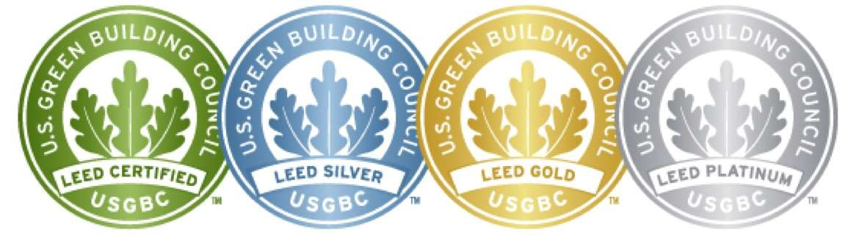

LEED
has
4
levels
of
certificates
Less Points
More Points

Slide 8
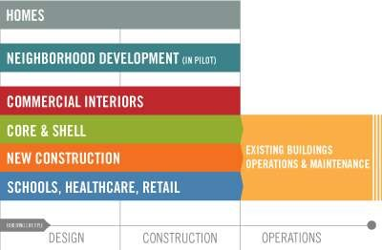
Types
of
LEED
certifications

Slide 9

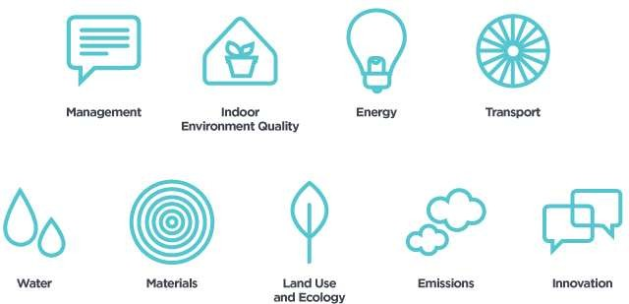
Green Star
Management 12
Indoor Environmental Quality 27
Energy 24
Transportation 12
Water 13
Design Innovation 5
Material 20
Land Use and Ecology 8
Emissions 14

Slide 10
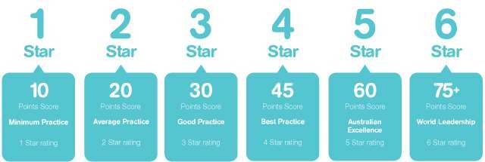
Green Star Rating Scale

Slide 11
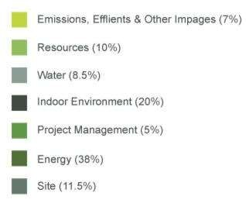
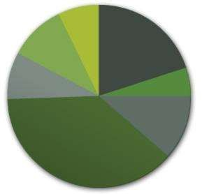
Green Globes
Canadian standards association Canada 2004
Project Management 50
Site 115
Energy 380
Indoor Environment 200
Water 85
Resources 100
Emissions 70

Slide 12
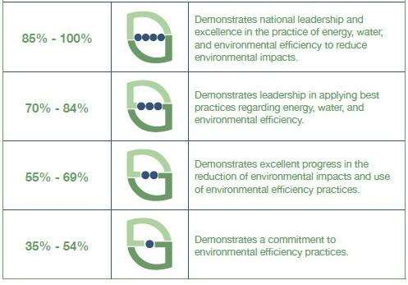
Green Globes Rating Scale

Slide 13
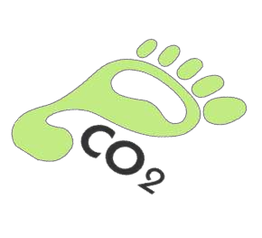
Why Green
Buildings?
How large are buildings’
carbon footprint anyway?

Slide 14
Impacts of U.S. Buildings on Resources
•
Buildings are responsible for…
•
•
•
•
40%
72%
39%
primary energy use*
electricity consumption* CO₂ emissions*
13.6% potable water
consumption**

Slide 15
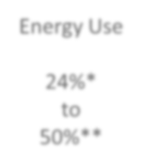
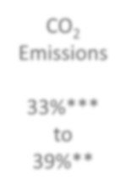
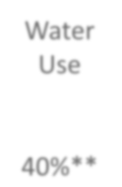





Green Buildings can
potentially
Water
Use
reduce…
Solid
Waste
Energy Use
CO2
Emissions
24%*
to
50%**
33%***
to
39%**
40%**
70%**

Slide 16
Perceived Business Benefits to Going
Green
•
Researches found…
•
•
•
•
•
8-9%
7.5%
6.6%
3.5%
operating cost decreases*
building value increases*
return on investment improves*
occupancy rate increases*
3% rent ratio increases**

Slide 17
Other benefits
•
Green building occupants are
healthier and more productive
•
In the U.S., people spend, on average,
90% or more of their time indoors*
•
Green buildings typically have
indoor air quality and lighting
better

Slide 18
How to register a Green
Building project?

Slide 19









Steps
to LEED Certification
Register your project
Track Progress &
Document Achievement
A few months to > 1 year
Apply for Certification

Slide 20
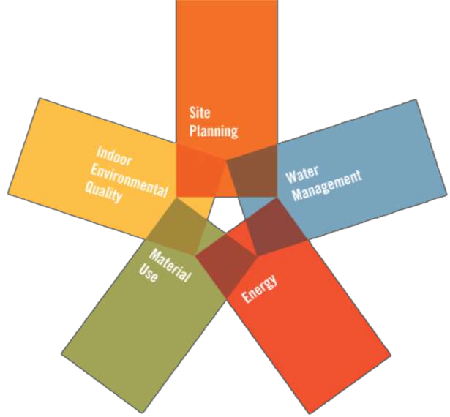
Dimensions of being ‘Green’

Slide 21
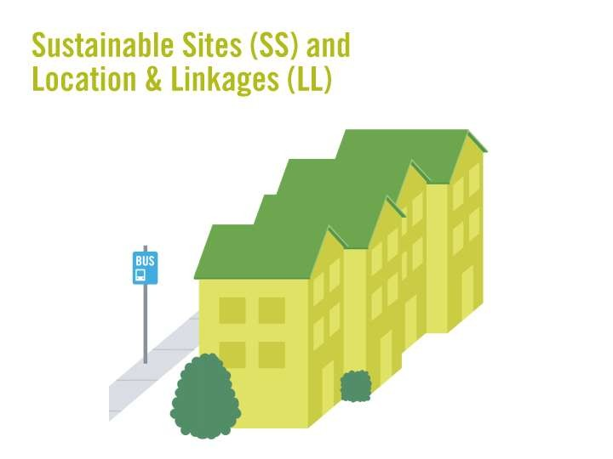
Good
Good
Good
location
transportation
building
design
Source: http://www.usgbc.org/DisplayPage.aspx?CMSPageID=1720

Slide 22
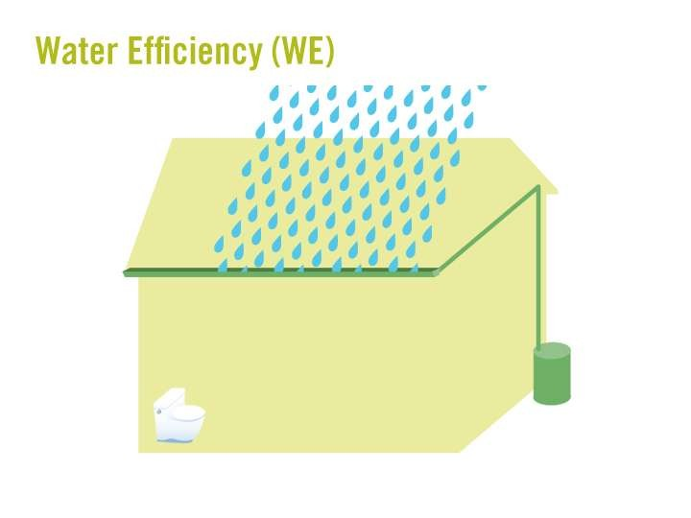
Water saving
technologies
Source: http://www.usgbc.org/DisplayPage.aspx?CMSPageID=1720

Slide 23
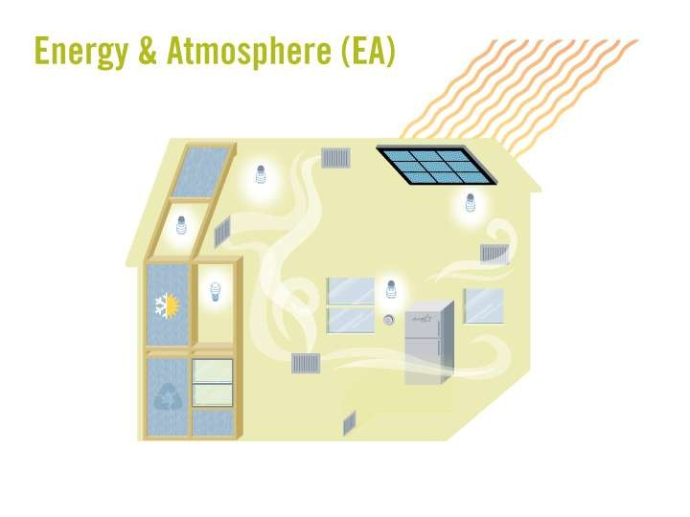
Highly
efficient
Lightings
and
HVACs
Source: http://www.usgbc.org/DisplayPage.aspx?CMSPageID=1720

Slide 24
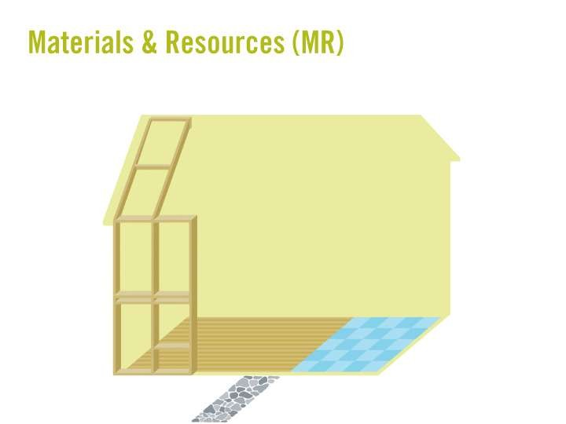
Environmentally friendly materials
Good waste management
plans
Recycling
programs
Source: http://www.usgbc.org/DisplayPage.aspx?CMSPageID=1720

Slide 25
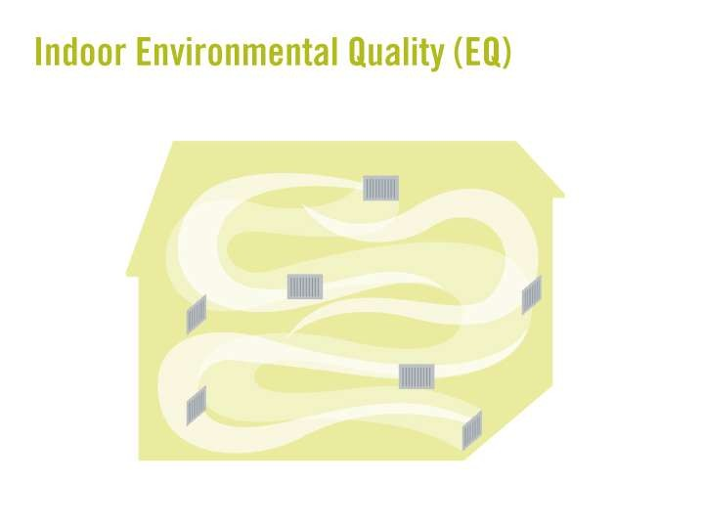
Clean breathing air
Good
Good
Good
ventilation
natural lighting
views
to
the
outdoors
Source: http://www.usgbc.org/DisplayPage.aspx?CMSPageID=1720

Slide 26
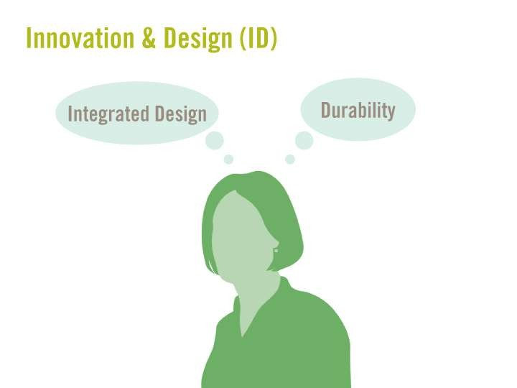


Source: http://www.usgbc.org/DisplayPage.aspx?CMSPageID=1720

Slide 27


Is our building ‘green’?

Slide 28


Let’s find out!!!

Slide 29
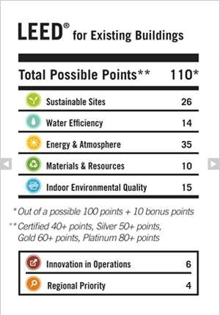

Slide 30
Some cool GREEN stuff…

Slide 31
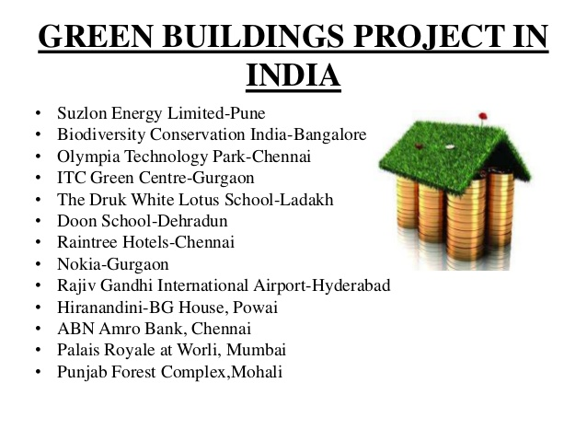

Slide 32
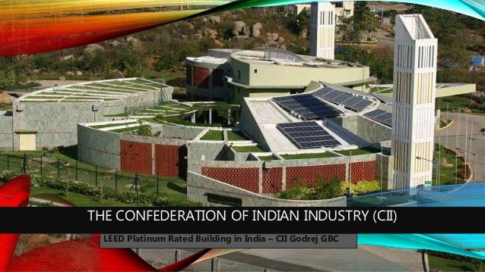

Slide 33
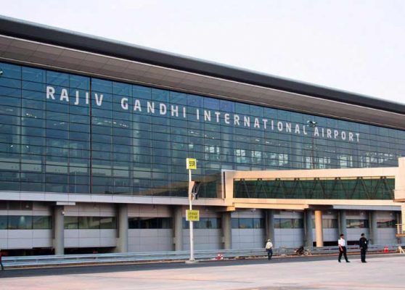
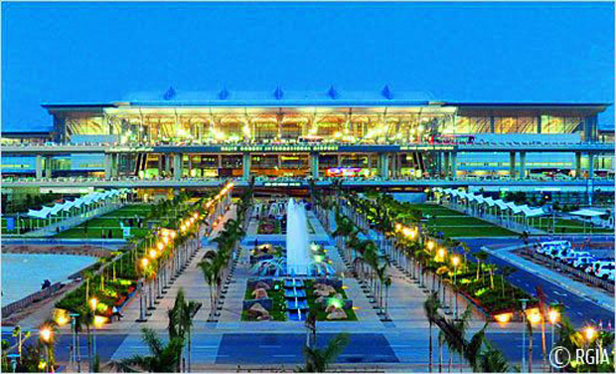
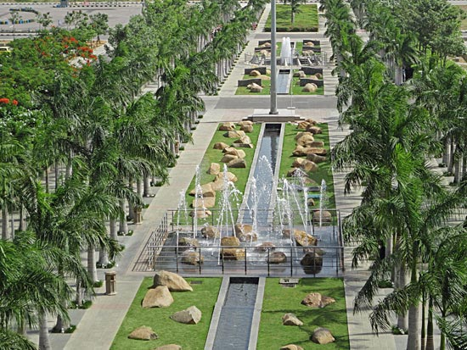

Slide 34
We
are
HULT!!!
Let’s do
something!!

Slide 35
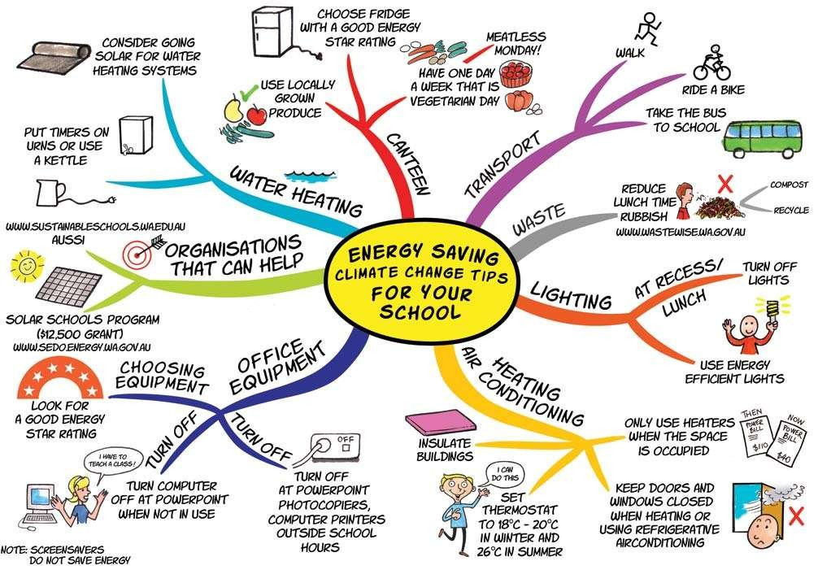

Source: http://live-the-solution.com/mindmaps/

Slide 36
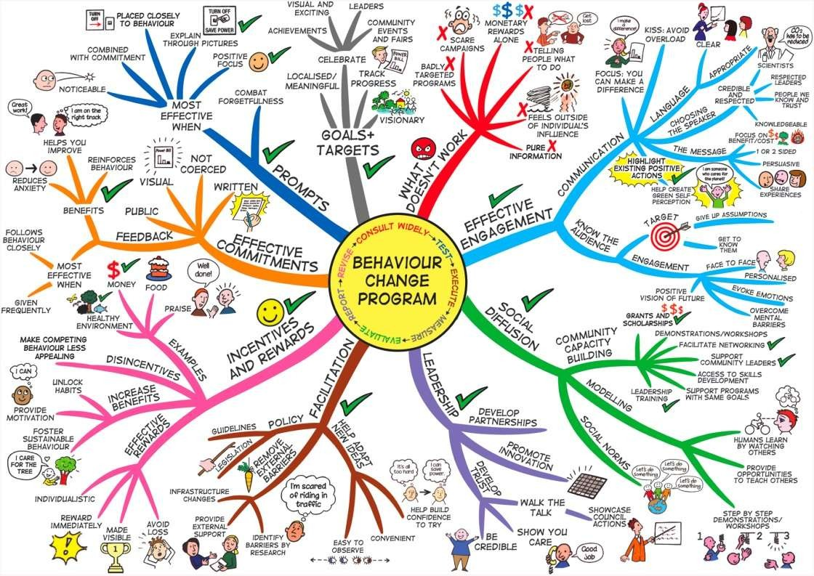
Source: http://live-the-solution.com/mindmaps/

Slide 37
THANK YOU!!

